Slide 1






MINITERM25
INTRO TO R & RSTUDIO
RP PORNMONGKOLSUK
JANUARY 2025
Notes:
Good morning, y'all!!!!
My name is RP, and I will be covering the introduction to R and RStudio this morning.
I know Andrew had gone over theoretical statistics last week, today we will see how to use a vastly powerful tool, programming, to basically do the math for us.
And how we’re going to do it this morning is that we will begin by getting to know each other a little bit first. Because I'm not here just to tell you what to do for 2.5 hours and leave, I want you to treat me like a resource and a connection – I will give you my contact at the end, so when you have questions, you can reach out to me at anytime. I will tell you a little bit of my story from when I was in your position, a high school student, and what kind of experience led me to doing a PhD in genetics today.

Slide 2


EXPECTATIONS
LEARNING OBJECTIVES
Example of science path from high school to PhD
What programming is and why we use R
How to use RStudio
Hands-on data analyses using R
RP PORNMONGKOLSUK
JANUARY 2025
Notes:
And that’s the first learning objective this morning – for you to hear one example of what a path from high school to PhD could look like, so you can learn something from my experience and hopefully make better informed decisions in your life regarding your science education!
I will go over a little bit of programming 101 and talk a little about R as a programming language. We will then get hands-on experience doing data analyses on data from the experiments that you performed, we’ll be doing that in a software called Rstudio.

Slide 3
EXPECTATIONS
GROUND RULES
Ask if you have questions
Tell me if I go too fast/slow
RP PORNMONGKOLSUK
JANUARY 2025
Notes:
I only have two rules, you know, besides normal high-school rules. One, if you have a question, please ask. Stop me at anytime. Two, let me know if I go too fast or too slow. Are we good.

Slide 4

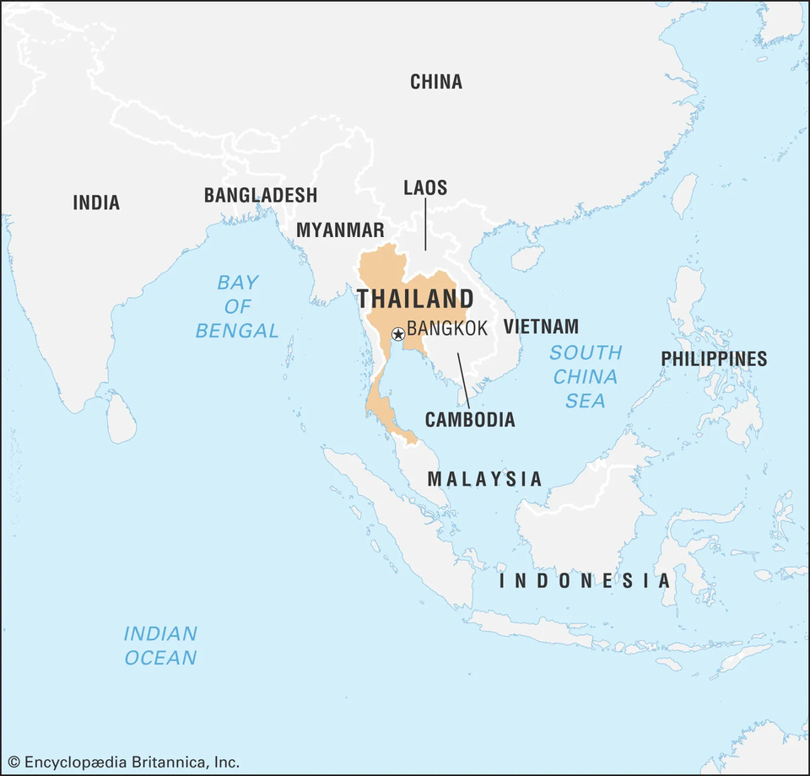


INTRODUCTION
RATCHANON
PORNMONGKOLSUK
OR JUST RP!
(he/him)
RP PORNMONGKOLSUK
JANUARY 2025
Notes:
My name is RP, I go by my initials because, why not, I mean, look at my full name. I'm from Thailand, and Thai names are really long. That’s also why Thai people use nicknames all the time! So, if you call me Ratchanon, it actually sounds less personal to me than calling me RP.

Slide 5

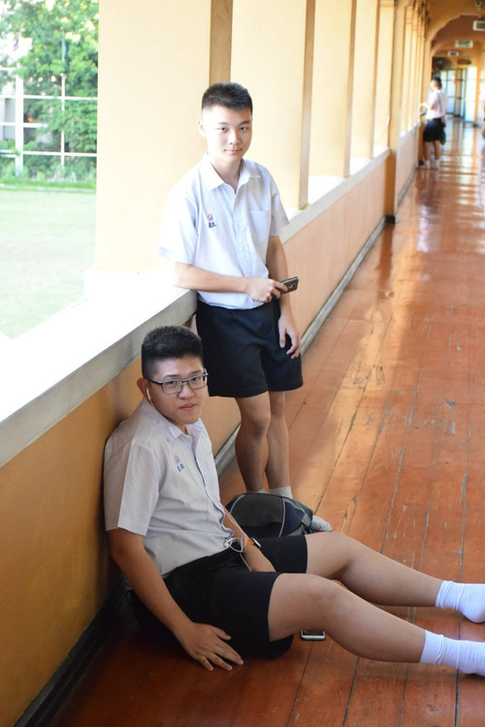
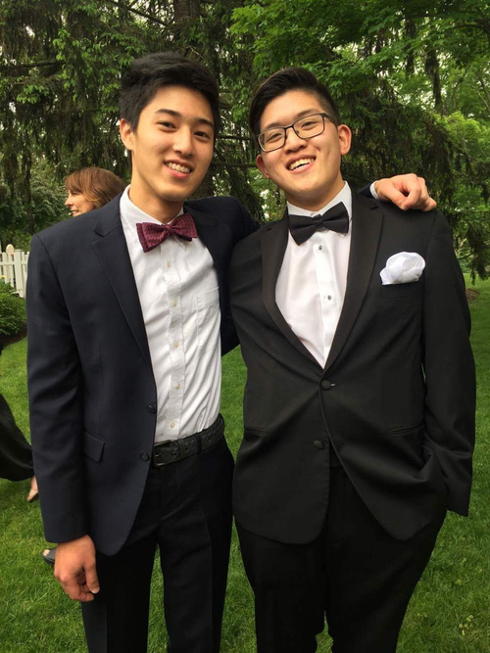
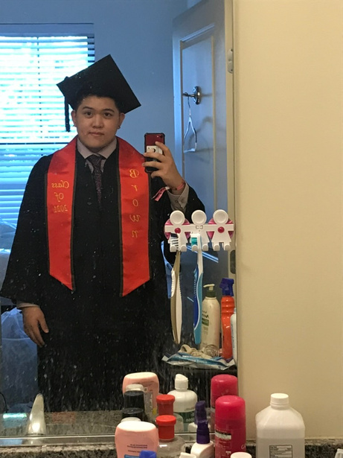


TIMELINE
THAILAND
BLAIR ACADEMY, NJ
BROWN, RI
DUKE, NC
1998 - 2016
2016 - 2017
2017 - 2021
2021 - now
RP PORNMONGKOLSUK
JANUARY 2025
Notes:
I grew up in Thailand, that’s me just hanging out with my buddy in front of my classroom. In my school, we had to wear the uniform, that’s why we were wearing the same thing. I graduated high-school in 2016 and got a scholarship from the Thai government to study in the US. So, I came here, and in my first year, I went to another high-school in New Jersey, called Blair Academy. It was in the middle of nowhere, but it was really nice. The purpose of it was basically to fill in the year in which I was supposed to be applying to college. That’s a photo of me with another Thai student at Blair. We had 3 Thai students total at the time. I was there for a year, and I then went to Brown University. There, in the middle of the pandemic 2021, I graduated with a degree in Biology. In the same year, I came to Duke for a PhD program in genetics and genomics, and the rest is history.

Slide 6

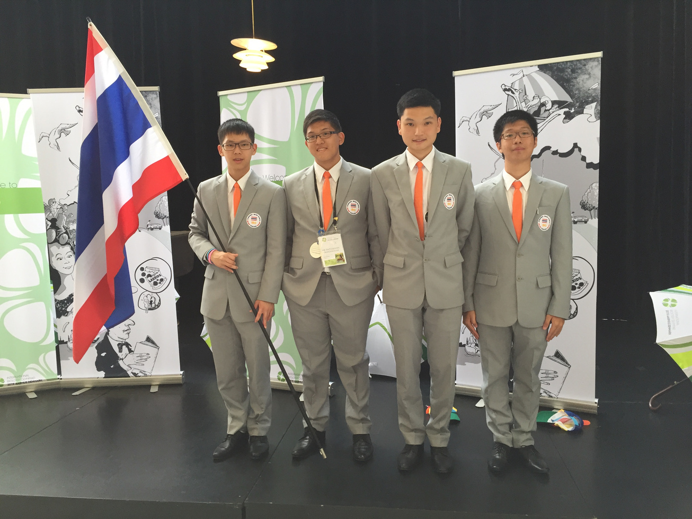
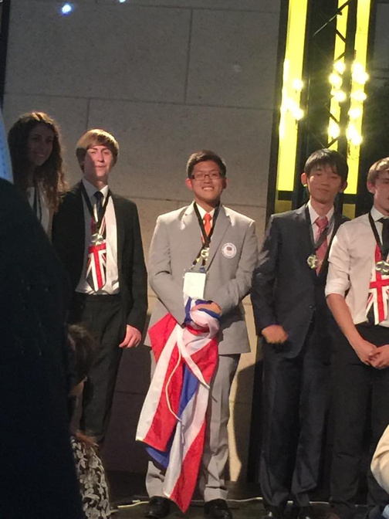

INTERNATIONAL BIOLOGY OLYMPIAD
DENMARK, 2015
Doesn’t know how to code
RP PORNMONGKOLSUK
JANUARY 2025
Notes:
I wanted to talk a bit about my most formative experience with science. In 11th grade, I had the great opportunity to represent Thailand at the International Biology Olympiad in 2015.

Slide 7

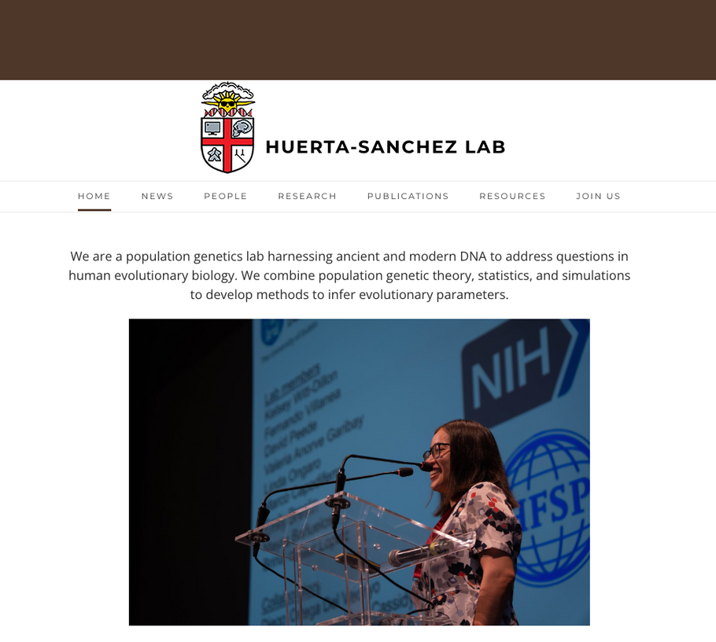
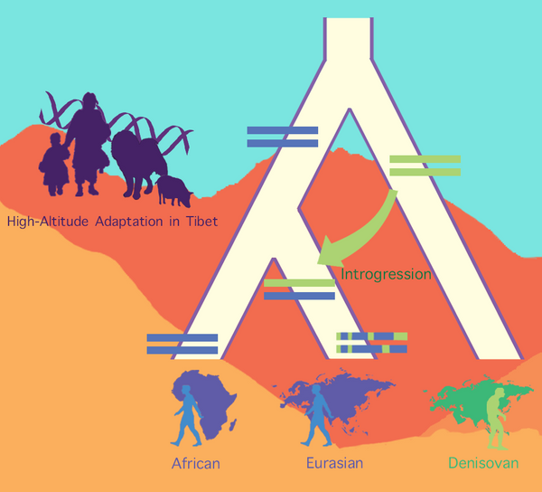
BROWN
domestication
archaic introgression
RP PORNMONGKOLSUK
JANUARY 2025

Slide 8
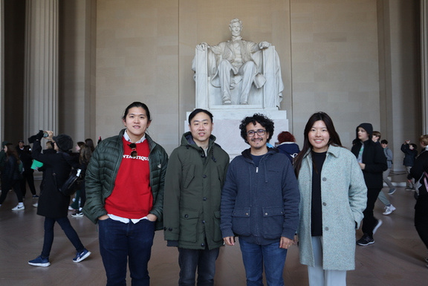
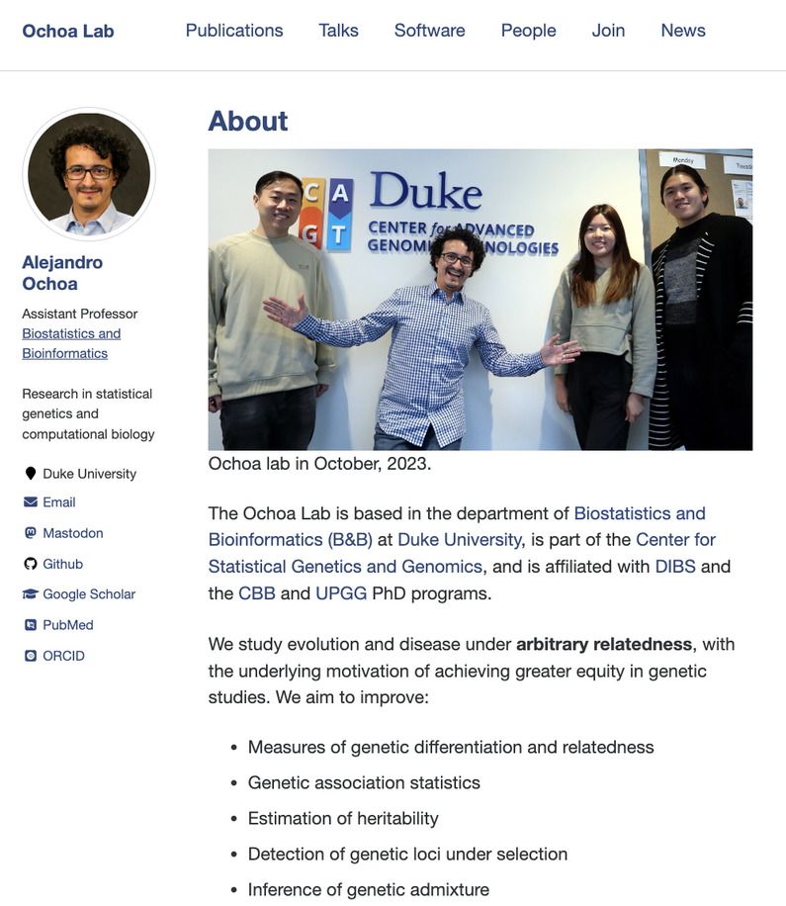

DUKE
“I study human evolution using ancient DNA”
RP PORNMONGKOLSUK
JANUARY 2025

Slide 9
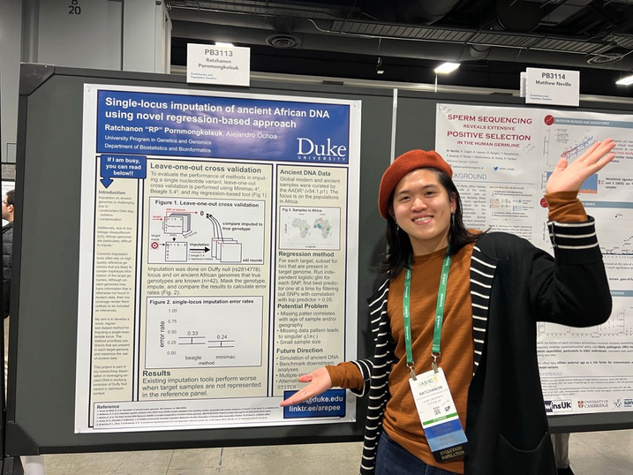
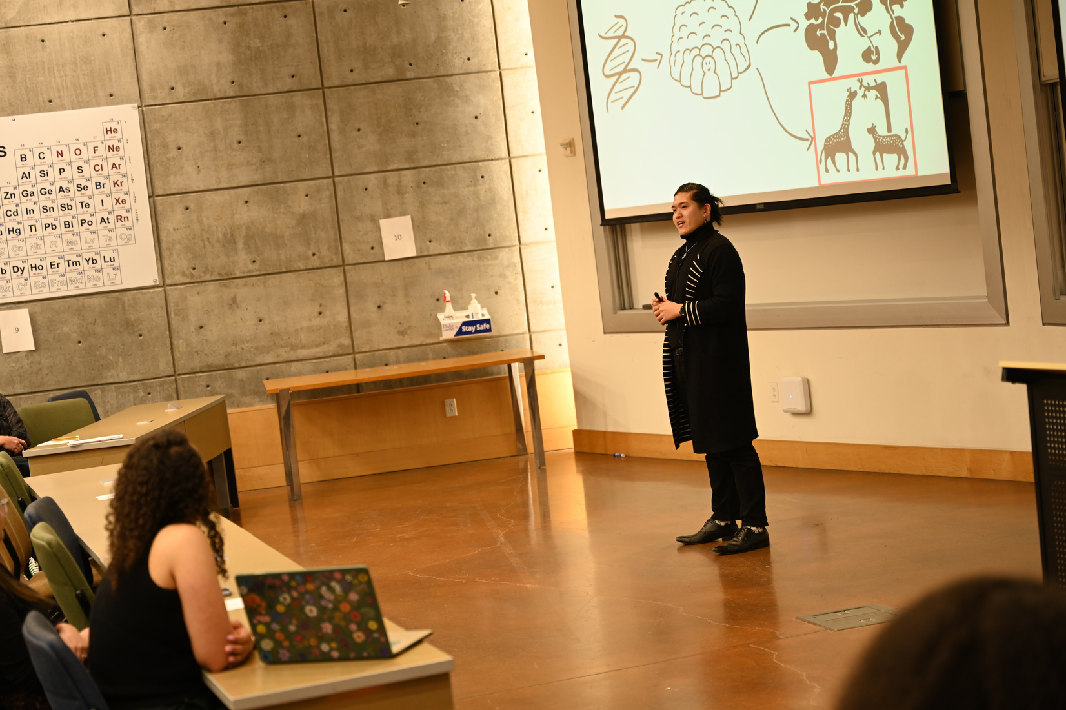
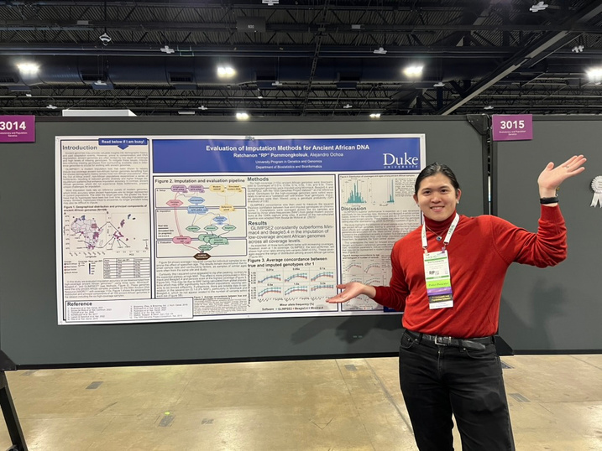
DUKE
ASHG* 2023
GradX 2024
ASHG* 2024
*American Society in Human Genetics
RP PORNMONGKOLSUK
JANUARY 2025

Slide 10


WHAT ABOUT YOU?
RP PORNMONGKOLSUK
JANUARY 2025

Slide 11
PROGRAMMING 101
RP PORNMONGKOLSUK
JANUARY 2025

Slide 12



INTRODUCTION
WHAT IS PROGRAMMING?
01101001
RP PORNMONGKOLSUK
JANUARY 2025

Slide 13

INTRODUCTION
01101001
RP PORNMONGKOLSUK
JANUARY 2025

Slide 14

TABLE/DATAFRAME
COLUMNS
TIME
GROUP
VALUE
1
A
0.33
ROWS
2
A
0.98
1
B
0.55
2
B
0.12
RP PORNMONGKOLSUK
JANUARY 2025

Slide 15

TABLE/DATAFRAME
TIME
GROUP
VALUE
1
A
0.33
2
A
0.98
1
B
0.55
VECTOR
2
B
0.12
RP PORNMONGKOLSUK
JANUARY 2025

Slide 16
RSTUDIO
01101001
RP PORNMONGKOLSUK
JANUARY 2025

Slide 17
RSTUDIO
01101001
RP PORNMONGKOLSUK
JANUARY 2025

Slide 18
DIRTY OUR HANDS
RP PORNMONGKOLSUK
JANUARY 2025

Slide 19
FEEDBACK & CONTACT
RP PORNMONGKOLSUK
JANUARY 2025

Slide 20


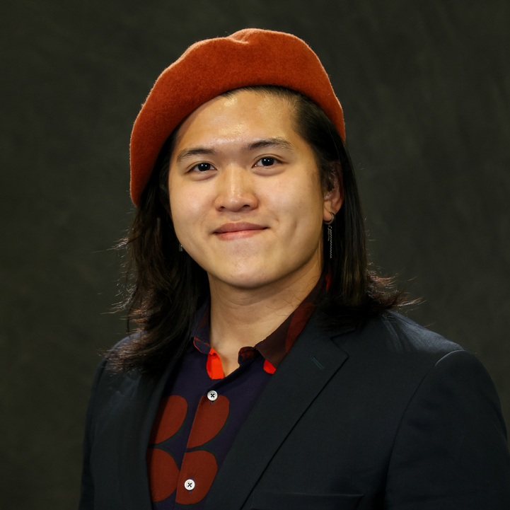
FEEDBACK & CONTACT
BIT.LY/MINI25-R
LINKTR.EE/AREPEE
RP280@DUKE.EDU
RP PORNMONGKOLSUK
JANUARY 2025

